Slide 1
City of Brownsville 2024 RTP Application
Iola Street Park Development

Slide 2
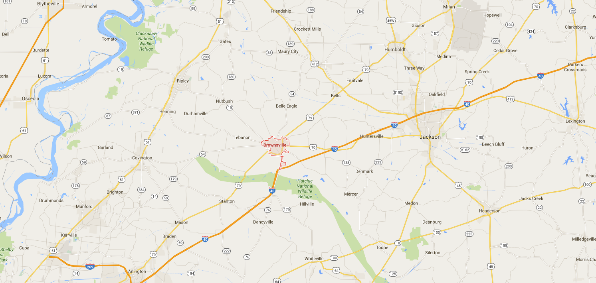
Census Population
City of Brownsville
Total Population: 9739
Total Households: 3,934
Haywood County
Total Population: 17,806
Total Households: 7,200
https://censusreporter.org/profiles/16000US4708920-brownsville-tn/

Slide 3
Recreational Acreage
The City of Brownsville has approximately
65 acres
of land dedicated to recreational acreage

Slide 4
Target Demographics
Proposed improvements at Iola Street Park will continue to make the recreational facilities available to all persons, regardless of age, gender, race, economic status, or possible disability.
The proposed improvements and upgraded facilities can be used by all ages.

Slide 5
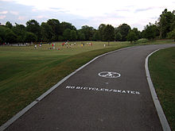
Public Recreation Activities/ Programs Envisioned at IOLA STREET PARK
Proposed:
Walking & Outdoor Recreation
Existing:
Vacant Land

Slide 6
Positive Community Impact
Recognizes needs outlined by the community in the 2024 Parks and Recreation Plan Update.
Improve public health by encouraging outdoor physical activity
Add to the recreational acreage available to the community.

Slide 7
Goal of Project At IOLA STREET PARK TRAIL
Develop a walking trail and ADA accessible facilities
Dedicate more land to recreational use within Brownsville and Haywood County
Encourage outdoor physical activity

Slide 8
Means & Funding For Development
Cash as match from the City of Brownsville
80% Grant, 20% Match

Slide 9
Suitability, Location, & Topography for Development of Project—Bond Park Trail Development
Repurposes a low-lying area
Currently the site is vacant
Area is ideal for trails and outdoor recreation

Slide 10
Site Development
The proposed project addresses needs identified in the 2024 Update of the Haywood County Parks and Recreation Master Plan
The site will have a walking trail and ADA accessible parking.

Slide 11
Programming Plans for Site
Iola Street Park Trail Development
Existing:
Vacant land
Future
More trail development
Playground
Proposed:
Construct a walking trail
Construct ADA accessible parking

Slide 12
State Comprehensive Recreation Plan Objective: Advocacy & Funding
The City of Brownsville has made great effort to address the State’s goal of advocating for recreational activities and programs through funding and planning. The City is constantly working to expand and maintain desirable recreational facilities and programs for citizens of Brownsville and surrounding areas. This has been demonstrated through the City’s yearly dedication of funds to Parks & Recreation facilities and programing. Utilization of RTP funds allow the City to increase the impact of the funding they have available for improvements and developments

Slide 13
State Comprehensive Recreation Plan Objective: Local Parks & Recreation
The City of Brownsville is dedicated to providing recreational facilities and programs to the citizens of Brownsville and surrounding areas. The Brownsville Parks and Recreation system has parks spread throughout multiple areas of town in order to make recreational facilities conveniently available to all citizens. The proposed 2024 RTP project will complete development and improvement activities in an area that is currently a

Slide 14
State Comprehensive Recreation Plan Objective: Public Health
All facilities within the Brownsville Parks and Recreation system encourage physical activity. The proposed project elements will enhance and expand the facilities to promote more physical activity outdoors.

Slide 15
State Comprehensive Recreation Plan Objective: Children In Nature
All of the proposed project activities will eventually encourage and enable the children of Brownsville and surrounding areas to play outside.
The proposed ADA walkway and accessibility improvements will provide a facility where handicapped parents and family members can bring their children without worrying about navigating the site. A lack of accessibility will no longer discourage children and family members from coming to Iola Street Park Trail Development for outdoor activities.

Slide 16
State Comprehensive Recreation Plan Objective: Quality Growth & Rural Economies
The City of Brownsville has and understanding for the importance of Quality Growth in the development of new recreational activities. All of the proposed activities will take place in areas that have already been developed and will not interrupt the valuable natural infrastructure of the West Tennessee.

Slide 17
State Comprehensive Recreation Plan Objective: Rural Economies
The City acknowledges the significance of the availability parks and recreational facilities to quality of life for its citizens. Industries looking into development in cities like Brownsville, want to see that there are ample activities for their employees and families to participate in outside of work. Quality and accessible outdoor areas like the one proposed at Iola Street Park Trail Development enhance the Brownsville Parks and Recreation System and show their commitment to exceptional facilities. Parks and recreational facilities are essential to maintaining and expanding the economies of rural areas of Tennessee.

Slide 18
Project Timeline
Submit Application May 2024
Receive Funding Award October 2024
Environmental Clearance Nov. – Jan 2025
State Contracting February 2025
Project Design March-May 2025
Bidding & Award June – July 2025
Construction August – Dec 2025
Project Close-out January 2026

Slide 19
Project Design Elements IOLA STREET PARK Trail Development
Use of Site
Walking trail development
Outdoor recreation
ADA accessible features and walkway will ensure that all citizens are able to use the new facilities

Slide 20
Project Design Elements Bond Park Trail Development
Access
The park is open to citizens between sunrise and sunset
Ease of Maintenance
The City of Brownsville has maintained been maintaining this land as well as similar park facilities around the city.
The proposed project activities will not create any new routine operational maintenance responsibilities for the maintenance staff.

Slide 21
Project Design Elements
The Total Project
is estimated at about
$425,000

Slide 22
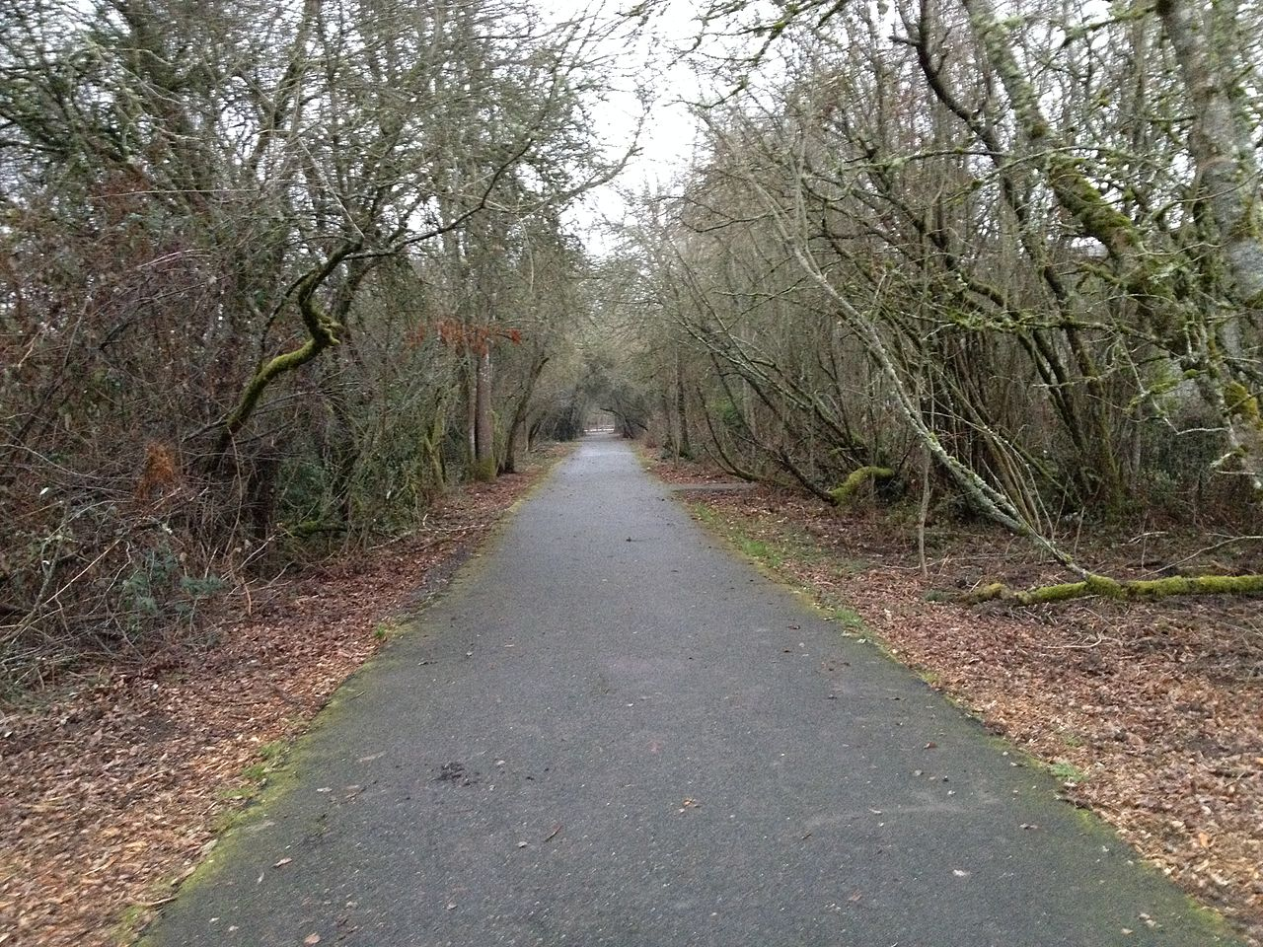
Pictures of Development Similar to those proposed in Iola Street Park Development

Slide 23
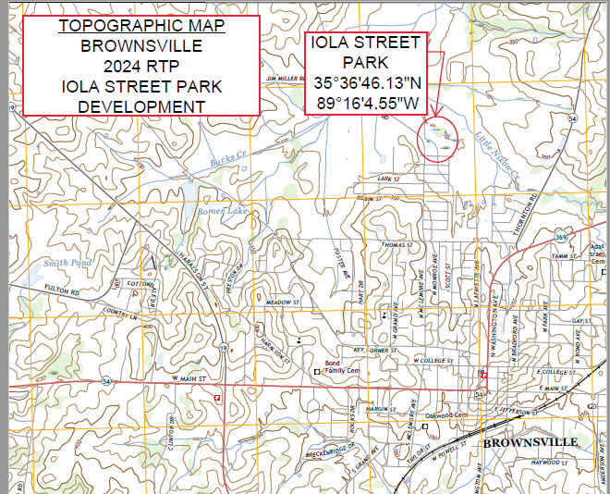

Slide 24
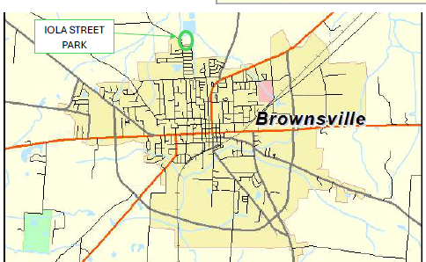
VICINITY MAP

Slide 25
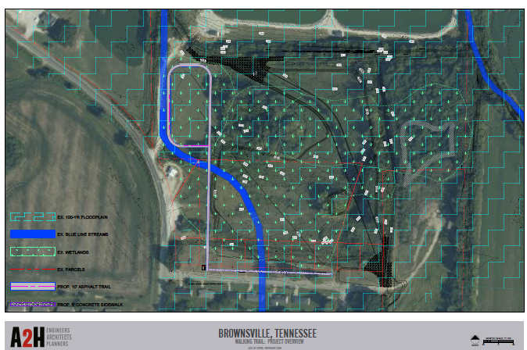
Preliminary Site Plan iola street Trail Development

Slide 26
Thank You For Considering Our Project!

